Slide 1
Memory Management and Virtual Memory
Evan Lee and Ryan Scott

Slide 2
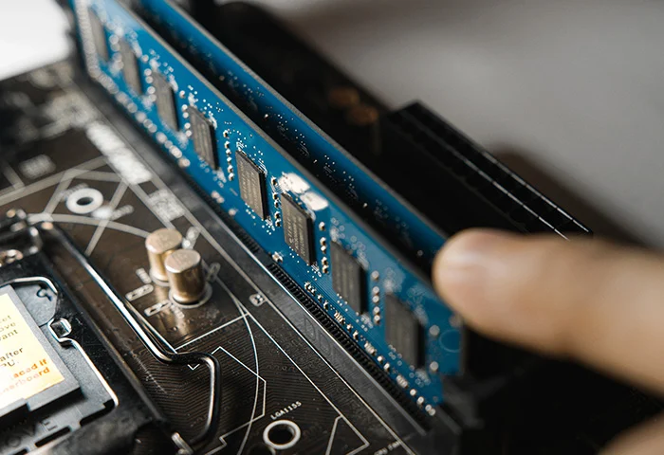
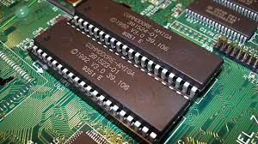
Primary Memory
Random Access Memory
Read Only Memory
ROM is non-volatile, meaning it is permanent storage that cannot change
Used for booting up the computer
Primary Memory = Fast access temporary storage
RAM is volatile, meaning it is temporary storage
Processes and applications are loaded into RAM

Slide 3
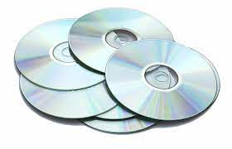
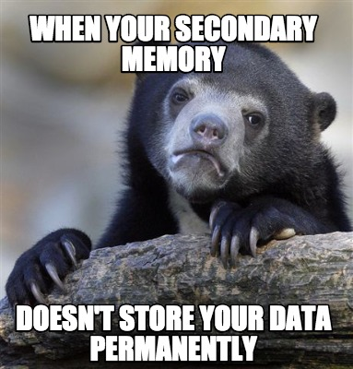
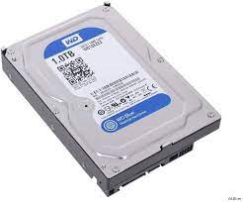
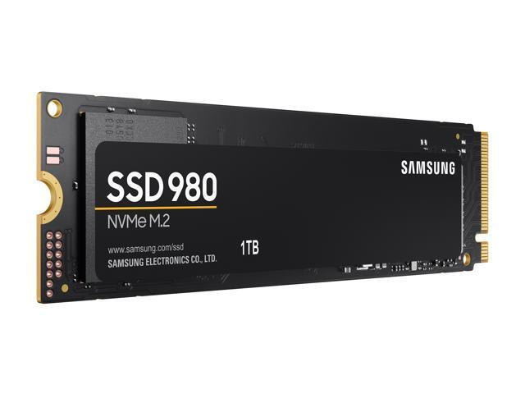
Secondary Memory
Secondary Memory = Long term storage
Cannot process data but can be moved into primary memory then moved back
Slower than primary memory but larger storage sizes

Slide 4
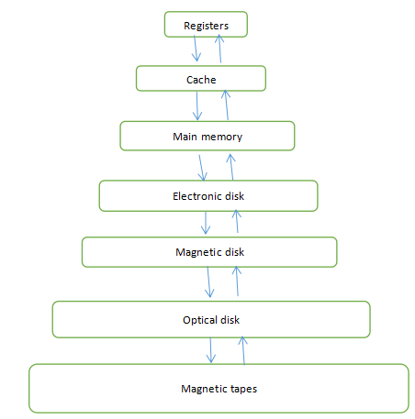
Memory Hierarchy
Different types of memory, stored in different places
Slowest on the bottom, fastest on the top in terms of access time
Biggest in size on the bottom, smallest on the top

Slide 5


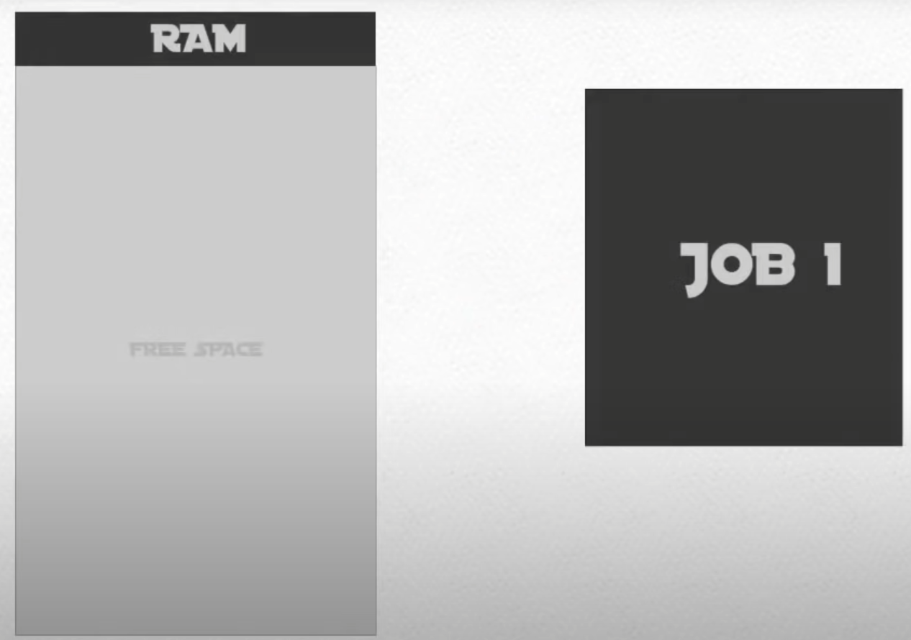
Single User Contiguous Memory
All of memory can only accept one job at a time
Once the process finishes, it is removed and the next process can be moved into RAM
If the process is bigger than the maximum RAM size, the process is unable to run

Slide 6
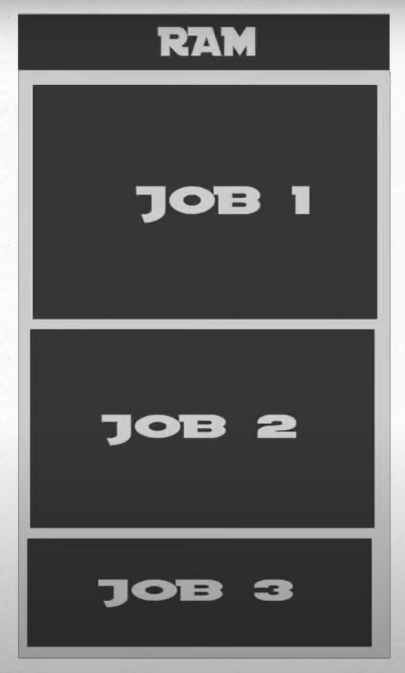
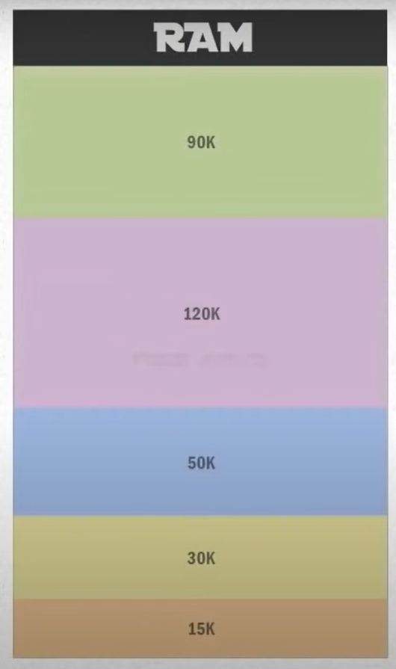
Fixed Partitions
To store multiple processes in main memory, one of the early techniques used was fixed partitions
Fixed partitions sizes are unchangeable and are made before execution or during system configure
Uses a partition memory table and contiguous allocation

Slide 7
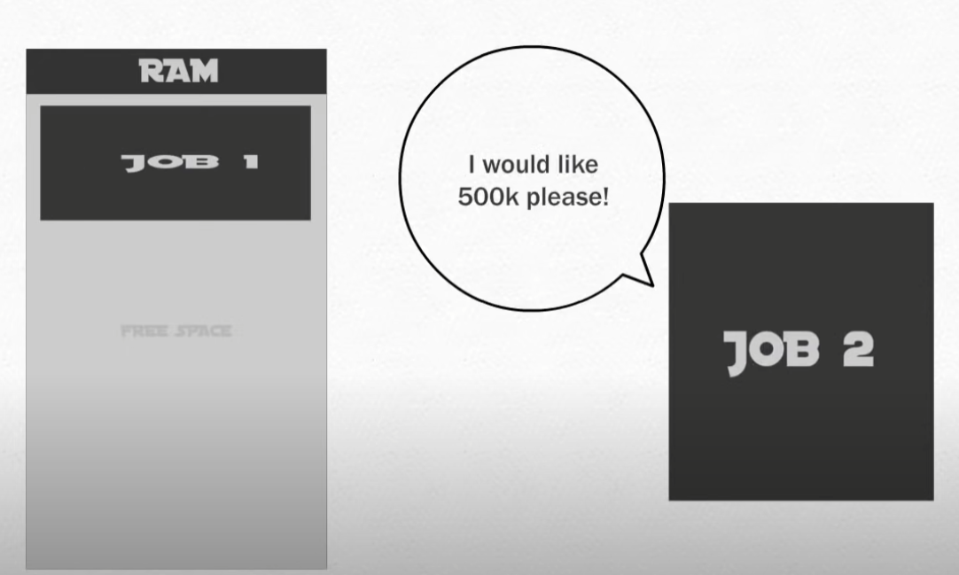
Dynamic Partitions
Still stored contiguously, but processes are granted the amount of memory they request
Memory is not wasted!
Issue arises when deallocating processes

Slide 8
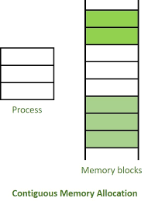
Problem with Single User Contiguous Memory, Fixed Partitions, and Dynamic Partitions
Main memory has to store the entire process
Can only store processes contiguously
Slow and inefficient

Slide 9
Life Before Virtual Memory
Life before Virtual Memory was primarily dictated by RAM and secondary memory (1)
At this time, computer memory was very expensive (1940s and 1950s)
The solution to getting around using more memory than was currently available was called overlaying (1)

Slide 10
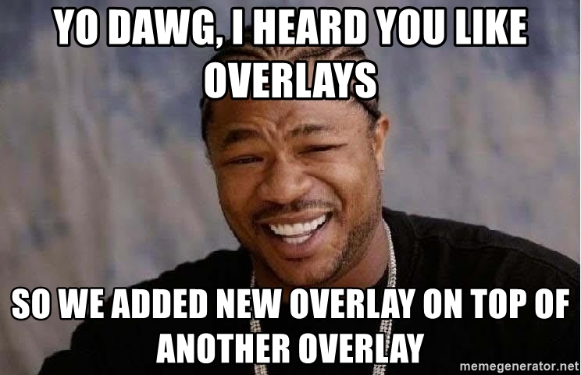
What is Overlaying?
Overlaying is a technique to run a program that is bigger than the size of physical memory. Whenever a process was running, it wouldn’t use the entire program at the same time, it instead only used some part of it (3).
The concept of overlaying centered around loading code in when you needed it, and unloading (replacing) it when you were done (3).
A lot of knowledge and effort was required on the programmer’s end to make overlaying work properly.

Slide 11
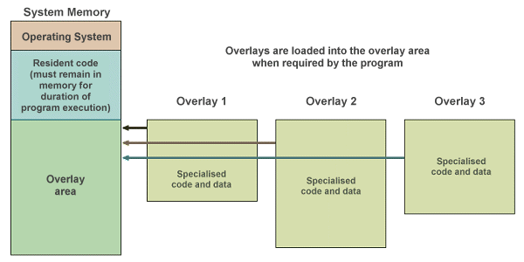
Visualization of Overlaying (5)

Slide 12
Pros and Cons of Overlaying
Pros:
Reduces memory requirements
Reduces time requirement
Cons:
Overlap map must be specified by programmer
Programmer must know the process’ memory requirement
Overlapping REQUIRES modular disjointed code
Complicates design and structures
Sufficient to say, it was a difficult and tedious task; a more simple and reliable way to handle this problem was needed. This paved the way for Virtual Memory.

Slide 13


What is Demand Paging?
Will only bring pages from secondary memory into main memory if the process executing demands it
Does not load pages in advance into main memory
Great for time sharing systems because it keeps the most clutter out of main memory
Takes up more memory to add the page map table

Slide 14
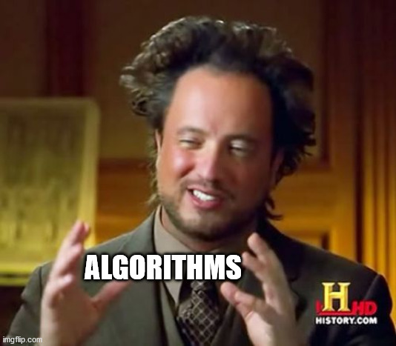
Page Replacement Methods
FIFO
Optimal Algorithm
LRU Page Replacement

Slide 15
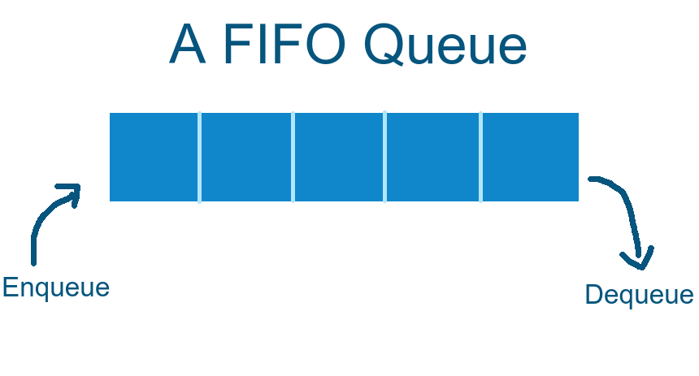
FIFO (First-in-first-out)
Simplest page replacement method
A queue system is set up to have the oldest loaded page at the front and newest in the back
When a new page needs to be loaded in and there is no more space, the page at the front of the queue will be replaced
Con: Does not keep track of how often the page is used and may need to reload it down the line
1 4 3 2 6
In this example, page 6 was loaded first and will be the first page to be replaced

Slide 16
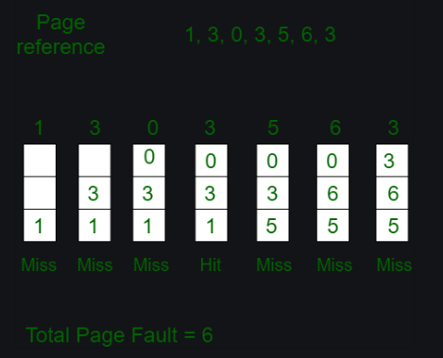
FIFO - Continued

Slide 17
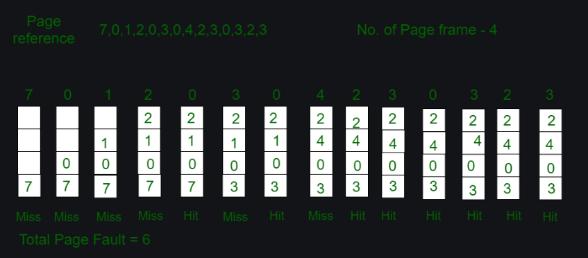
Optimal Algorithm
Will produce the least amount of page faults but requires to have insight of the page references which a memory manager will not know
Will be able to look into the future and remove the page that is used the least
Replaces pages 7 and 1 since they are not used in the future

Slide 18
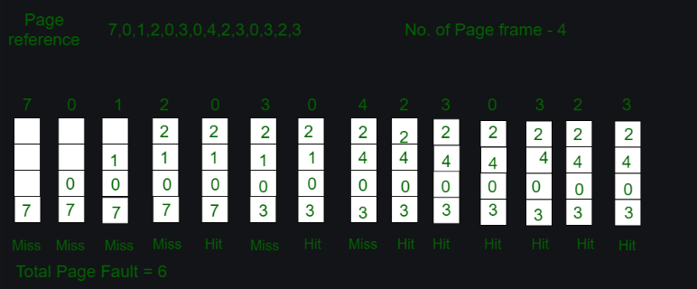
Least Recently Used (LRU) Page Replacement
Similar results to the optimized method, but instead of looking into the future it looks into the past to see the last used page
When loading page 3 and 4, it looks back to the front to see which was the last used page

Slide 19
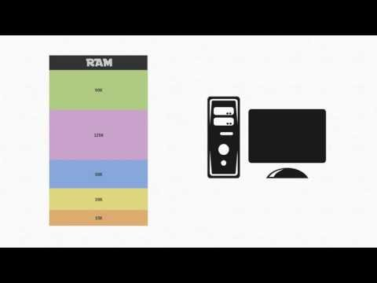
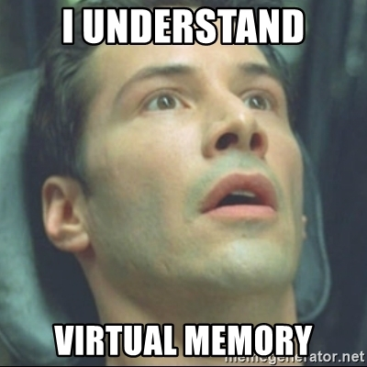
What is Virtual memory?

Slide 20
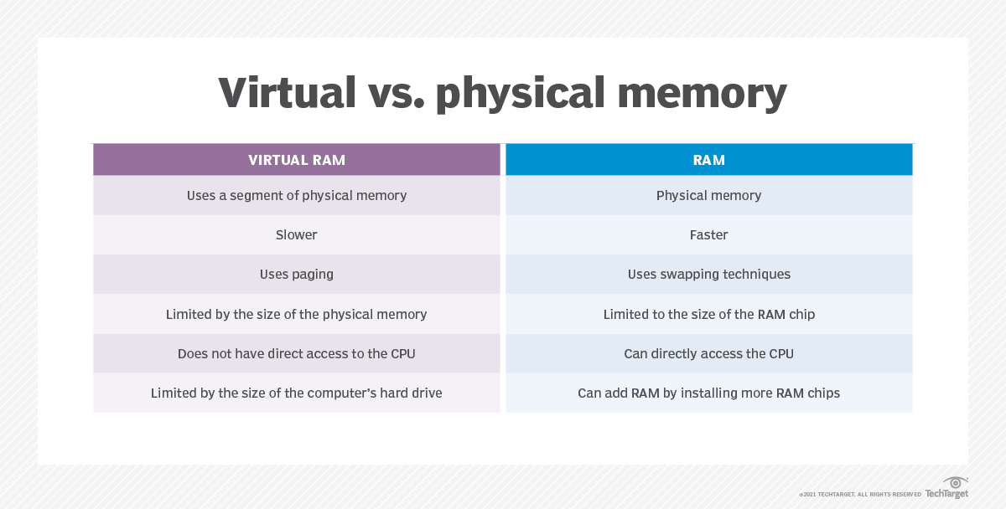
https://www.techtarget.com/searchstorage/definition/virtual-memory

Slide 21
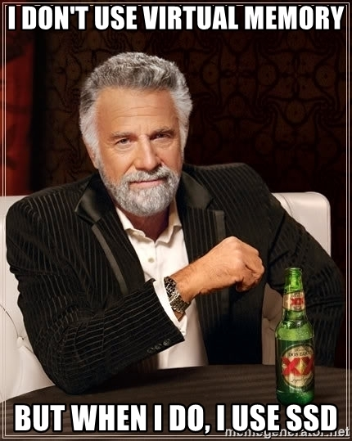
Advantages of Virtual Memory
Allows you to run more applications at once!
Can go above and beyond physical memory
Common data or code may be shared between memory
Very helpful for multiprogramming!

Slide 22

Disadvantages of Virtual Memory
Applications may run slower when using Virtual Memory
Generally takes more time to switch between applications
Reduces your hard-drive space
Reduces system stability
Overall net negative to system performance
Virtual Memory
System Instability

Slide 23
Thrashing
Thrashing is a state in which the CPU performs 'productive' work less, and 'swapping' more.
Thrashing occurs when a computer's virtual memory resources are overused, leading to a constant state of paging and page faults, inhibiting most application-level processing
Looks something like this

Slide 24
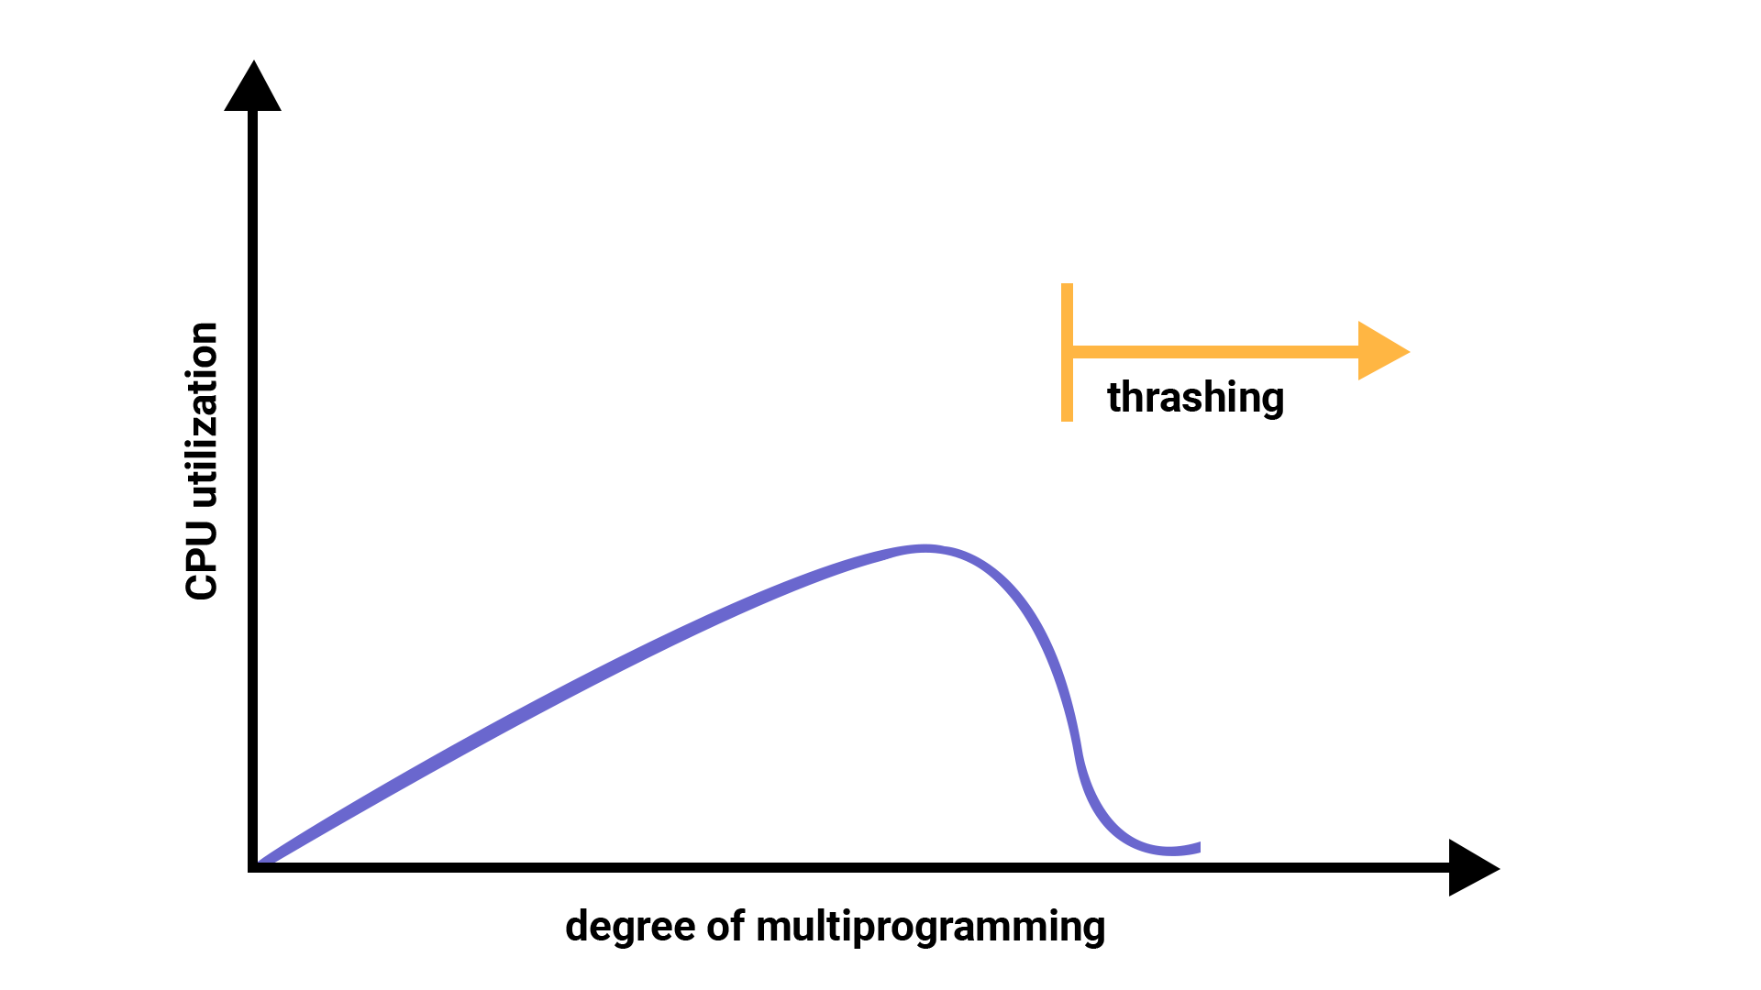
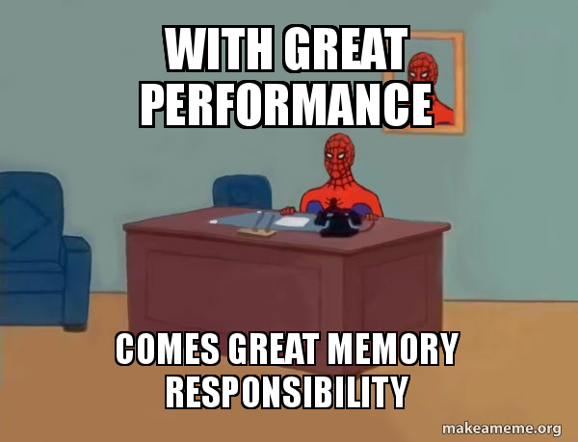
Consequences of Thrashing
Thrashing causes the performance of the computer to degrade or collapse.
The situation can continue indefinitely until either the user closes some running applications or the active processes free up additional virtual memory resources.

Slide 25
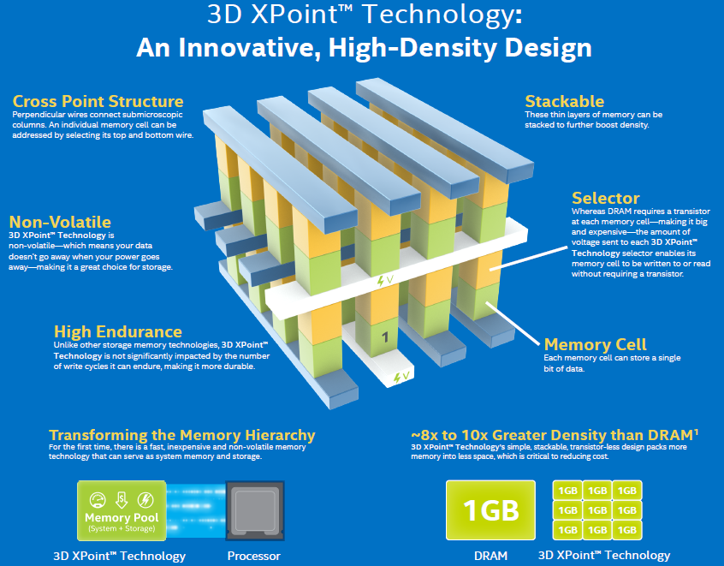
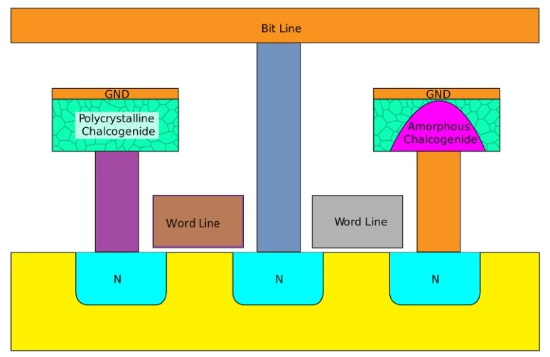
The Future of Memory Management? (PCM)
Phase-change memory is a type of non-volatile random-access memory. PRAMs exploit the unique behaviour of chalcogenide glass.
The goal for some people interested in emerging memory technology is a single memory type for both storage and computing, in which any amount of memory attached to the system can be used for either purpose. New technologies such as PCM promise to bring that goal to reality within the next decade.

Slide 26

Thanks for listening!

Slide 27
References
https://www.techtarget.com/searchstorage/definition/virtual-memory
https://www.youtube.com/watch?v=qdkxXygc3rE
https://www.geeksforgeeks.org/overlays-in-memory-management/
https://www.technologyuk.net/computing/computer-software/operating-systems/memory-management.shtml
https://www.geeksforgeeks.org/memory-management-in-operating-system/
https://en.wikipedia.org/wiki/Phase-change_memory

